Slide 1
COVID-19 IN NYC
Jenya Lee

Slide 2
AGENDA
Introduction
Motivation
Data Source
Methodologies
Findings and conclusions

Slide 3
INTRODUCTION
2/29/2020 – 1st confirmed case in NYC
3/10/2020 – When Healthfirst announced WFH due to COVID
COVID-19 has been affecting our lives since March 2020. NY was one of the places that had the highest confirmed case count. For NYC, how has the number of cases changed over the time?
Which borough has the highest confirmed cases?
What months had confirmed cases spike?
What months did cases start slowing down?
How does the hospitalization rate change over time?

Slide 4
MOTIVATION
At the beginning of the pandemic, I was very worried. I kept track of the case count every day. I had food enough for a month prepared. I didn’t leave my house for months, and only a year later I tried eating at restaurant again. I haven’t paid much attention to how many confirmed cases since then. I want to revisit COVID-19 case count, see how things have changed.

Slide 5
Data Source
COVID-19 Daily Counts of Cases, Hospitalizations, and Deaths from NYC OpenData
Data since 2/29/20, first confirmed case of NYC
62 columns
795 rows
Case count for NYC total and 5 boroughs
https://data.cityofnewyork.us/Health/COVID-19-Daily-Counts-of-Cases-Hospitalizations-an/rc75-m7u3

Slide 6
Data Source
Variant epi data from NYC Health.
A small proportion of all confirmed COVID-19 cases were sequenced citywide.
based on a small subset of all confirmed COVID-19 cases. Because patients who have specimens sequenced are likely to be different than those that do not, findings may not be representative of all confirmed COVID-19 cases citywide and should be interpreted with caution.
This file contains the counts and percentages of confirmed cases, by SARS-CoV-2 variant.
Data since 01/02/21, reported weekly
70 rows
https://github.com/nychealth/coronavirus-data/blob/master/variants/variant-epi-data.csv

Slide 7
Data Source
Weekly Breakthrough data from NYC Health.
contains weekly counts and rates of cases and hospitalizations by vaccination status, and citywide.
Data since 1/17/2021 when vaccine became available
https://github.com/nychealth/coronavirus-data/blob/master/trends/weekly-breakthrough.csv

Slide 8
Methodology
Python: Pandas, Matplotlib, Seaborn
Renaming columns for cleaner look
Dropping columns and rows: dropping data from 5/1-5/3/2022
Changing the date from object to datetime
Plots
Tableau

Slide 9
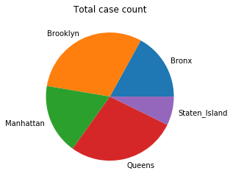
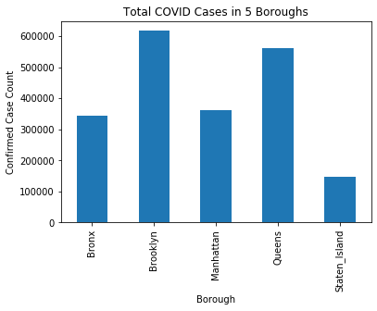
Total covid cases In NYC boroughs
BROOKLYN | QUEENS | MANHATTAN | BRONX | STATEN ISLAND | NYC
617,343 | 562,038 | 360,754 | 345,136 | 147,287 | 2,033,081

Slide 10
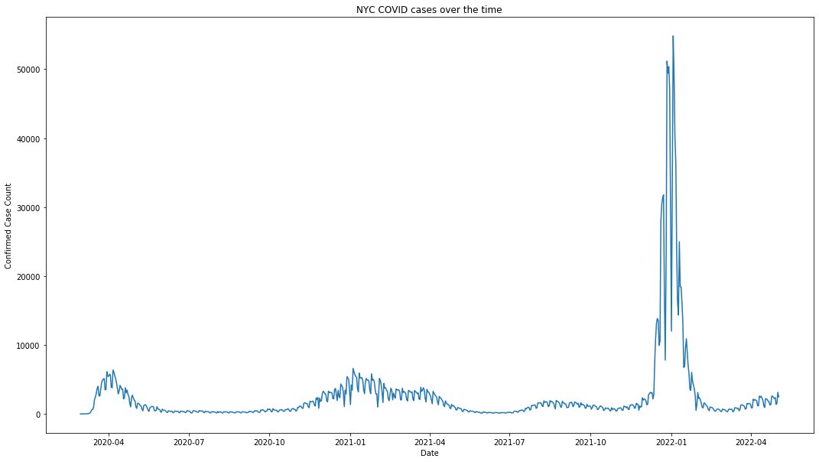
NYC COVID CONFIRMED CASES
The date with the highest confirmed case in:
2020: 4/6/2020 (6,353 cases)
2021: 12/27/2021 (51,172 cases)
2022: 1/3/2022 (54,834 cases)
Cases increased in 4/2020, 1/2021, and reached the peak in 1/2022. In 2/2022, the confirmed case count started to decrease to less than one tenth of its peak count. At the end of 4/2022, cases start to increase.
*In 2020 March, April, and early May, the NYC Health Department had discouraged people with mild and moderate symptoms from being tested.

Slide 11
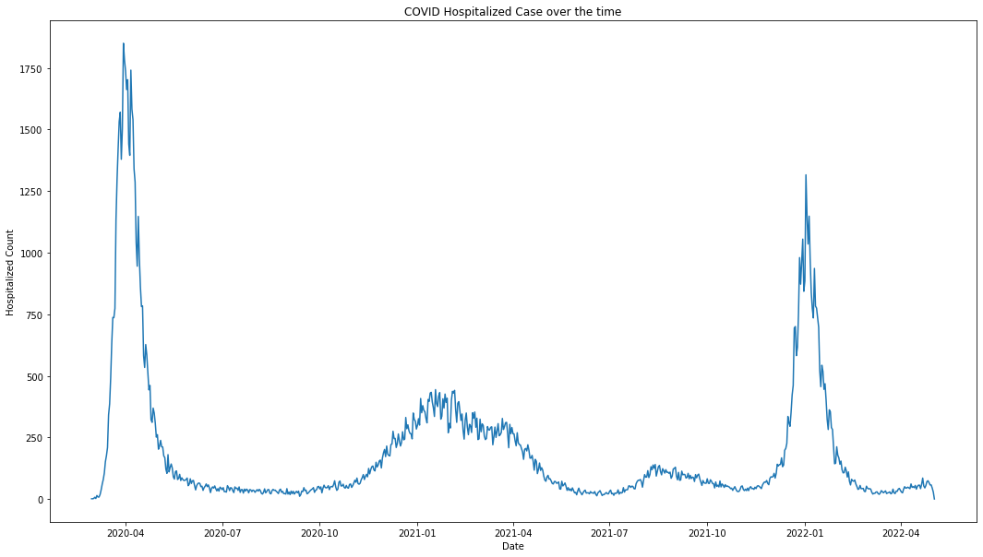
NYC COVID hospitalization count
The date with the highest hospitalization in:
2020: 3/30/2020 (1,850 cases)
2021: 12/30/2021 (1,055 cases)
2022: 1/2/2022 (1,316 cases)
Even though in Jan 2022, the confirmed cases reached 40k a day, but hospitalization rate was relatively low comparing to the confirmed case count, the highest was around 1,316. Back in April 2020, when COVID just hit NYC, there were 1,850 cases on the highest count day.

Slide 12
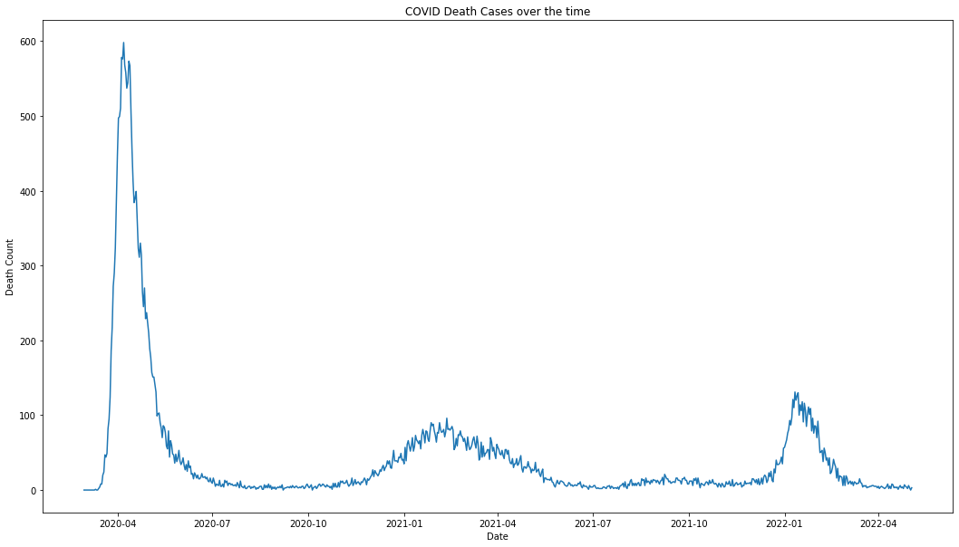
NYC COVID DEATH count
The date with the highest death in:
2020: 4/07/2020 (598 cases)
2021: 2/11/2021 (96 cases)
2022: 1/11/2022 (131 cases)
In this plot, it showed April 2020 had the highest death count in a day. It looks similar to the previous Hospitalization plot. It is because comparing the what first hit NYC, COVID has mutated to Omicron, which is much more contagious but much less deadly.

Slide 13
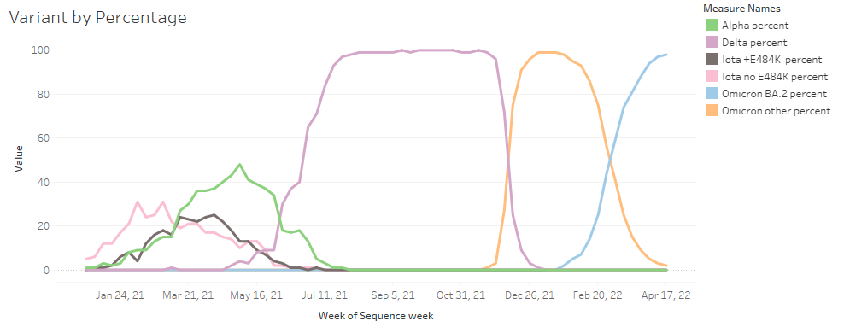
Variant by percentage
In July 2021, percentage of Delta Variant amount tested cases were increasing to nearly 100% during September to October. Omicron (Other) started to spread and reached its peak in January 2022, then it came down to have the top placed taken over by another Omicron variant.

Slide 14
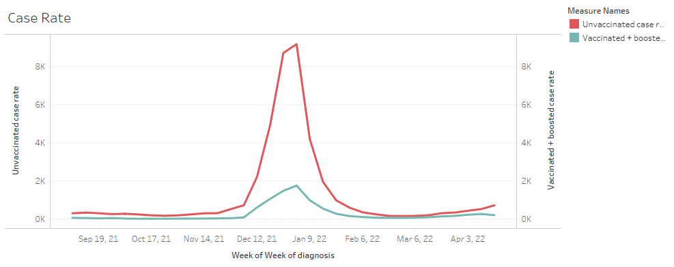
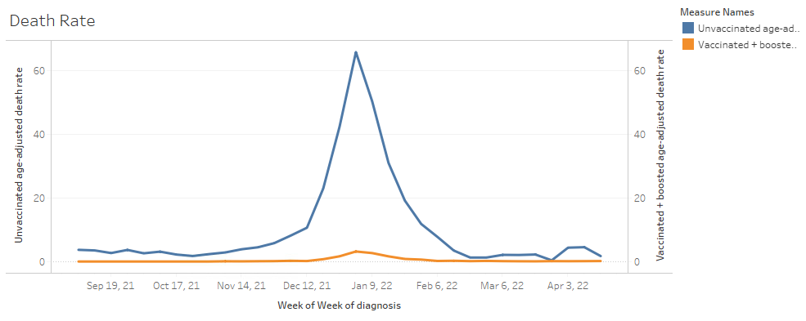
Unvaccinated vs vaccinated & boosted
Rate of case/death is per 100,000 people unvaccinated/vaccinated & boosted.
1/2/2022
Case rate:
Unvaccinated: 9,177
Vaccinated & Boosted: 1,750
Death rate:
Unvaccinated: 65.76
Vaccinated & Boosted: 3.15
Vaccinated and boosted significantly protect us from COVID-19

Slide 15

Unvaccinated vs vaccinated & boosted
COVID NYC 9/11/2021 – 4/23/22:
Death rate:
Unvaccinated: 10.158
Vaccinated & Boosted: 0.405
CDC estimated rates of flu-related disease outcomes
US 2018-2019:
Death rate:
5-17 yrs: 0.3
18-49 yrs: 1.2
50-64 yrs: 7

Slide 16
conclusion
December to February are the months that we need to watch out as there are higher confirmed cases around those time.
COVID has become less deadly, however very contagious.
Even though the pandemic has not ended yet, it is so much different from what it was at the beginning.
Things won’t go back to how they were pre-pandemic, and we don’t know when the pandemic will end, what we can do is continue to maintain good hygiene.

Slide 17
reference
Estimated Flu-Related Illnesses, Medical visits, Hospitalizations, and Deaths in the United States — 2018–2019 Flu Season https://www.cdc.gov/flu/about/burden/2018-2019.html

Slide 18
THANK YOU
Stay healthy!

